Slide 1
REVIEW-1 Employee_Tracking_System
Presented by:
2010030463_M.Anil kumar
2010030490_K.Varun krishna
2010030526_D.Dedeepya
2010030530_K.Sriteja
Guided by:
Madhukar Rao sir
Sasidhar sir

Slide 2
Table of Contents
Documentation (literature review)
Github setup
Work allocation to team members
Data set collection and tools setup

Slide 3
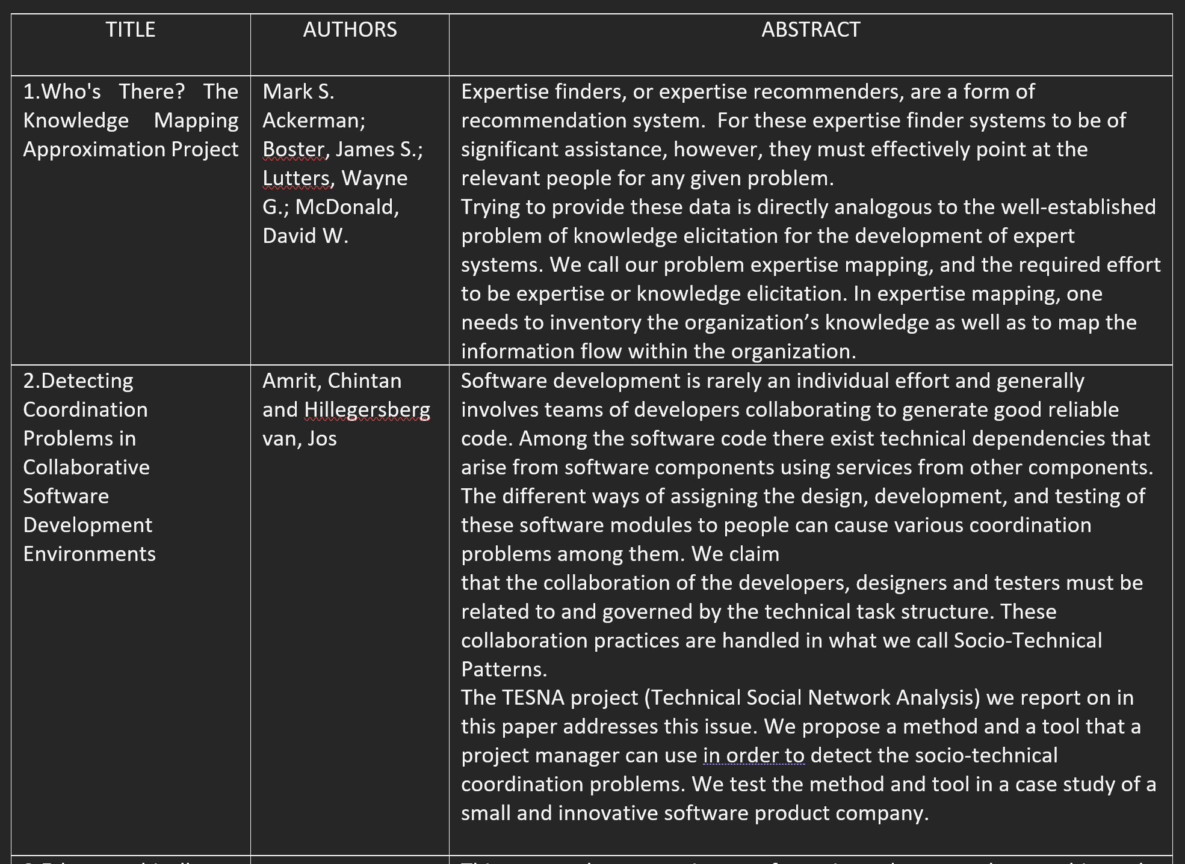
Documentation (literature review)

Slide 4
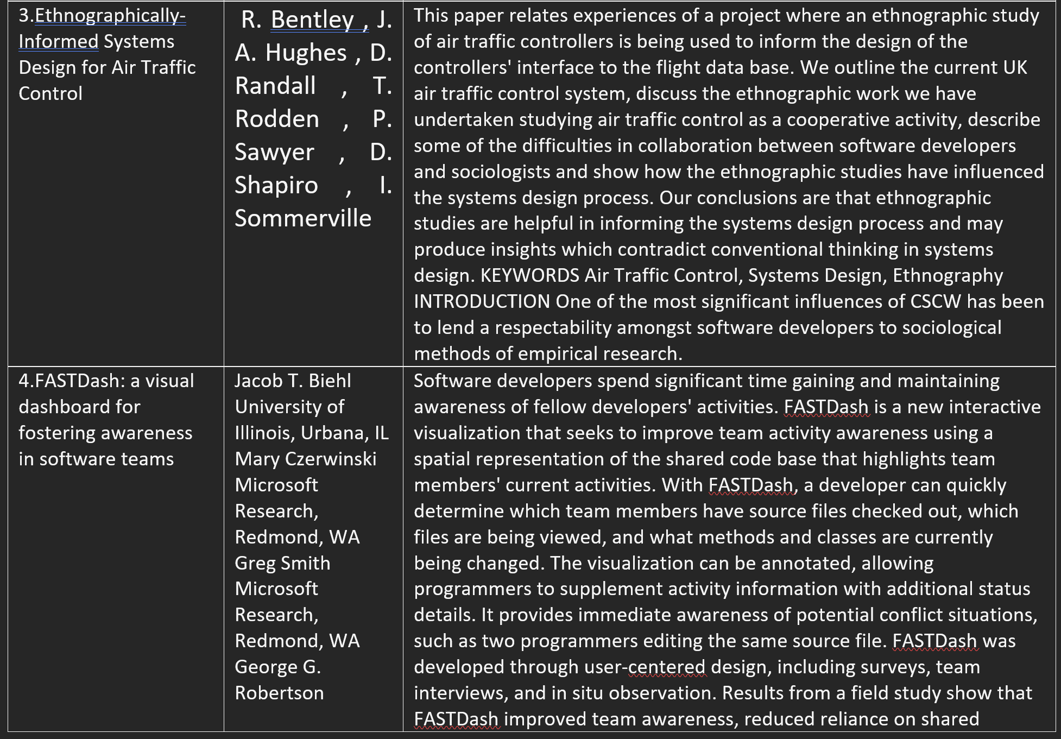

Slide 5
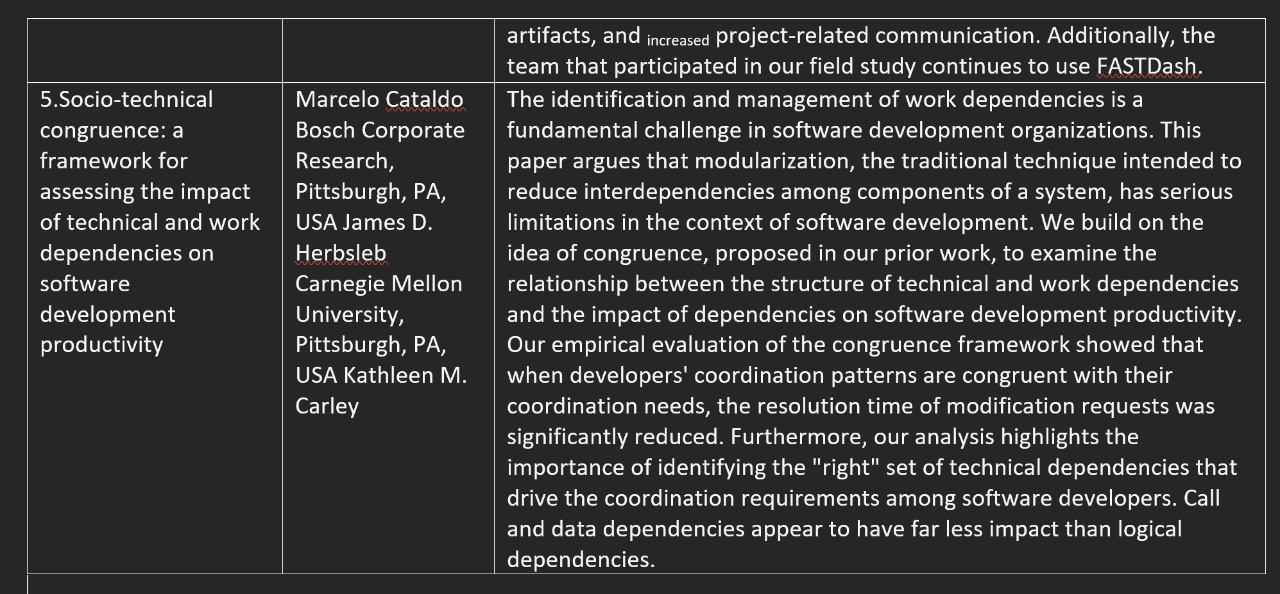

Slide 6
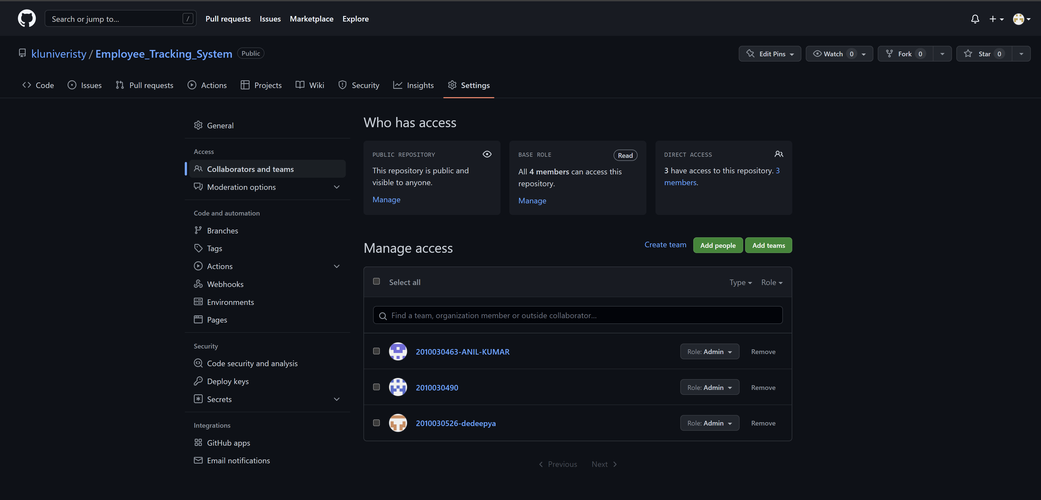
Github setup

Slide 7
Work allocation to team members
Front end – Anil
Flowchart – Varun
Code and implementation – Dedeepya and Sriteja

Slide 8
Data set collection and tools setup
Data set- we define our own data .such as employee details,
manager details, admin details.
Tool setup
HARDWARE REQUIREMENTS:
System : Pentium i3 Processor
Hard Disk : 500 GB.
Monitor : 15’’ LED
Input Devices : Keyboard, Mouse
Ram : 2 GB
SOFTWARE REQUIREMENTS:
Operating system : Windows 10.
Coding Language : JAVA.
Tool : Netbeans 8.2
Database : MYSQL

